Slide 1

We believe in hospitality with a green heart
Made by: Zoë Meershoek and Balázs Gaál

Slide 2
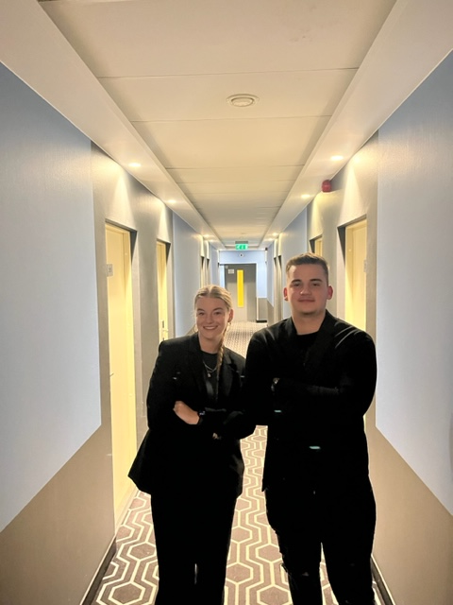
Who are we?

Slide 3
Table of contents
Micro analyze
Meso analyze
Macro analyze
Concept
Round 1 – 6
Conclusion

Slide 4
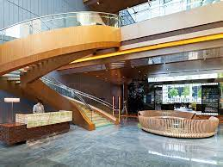
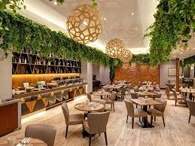
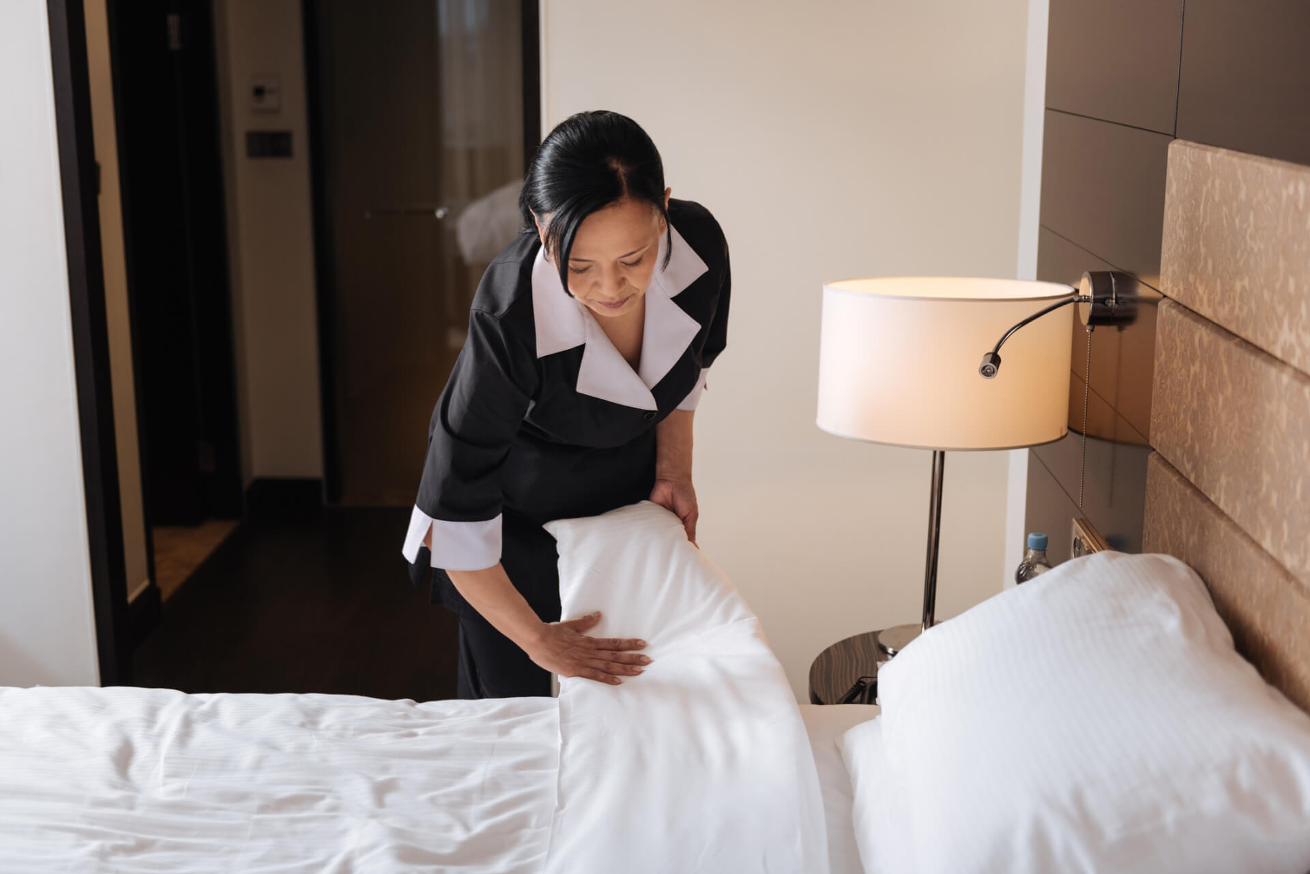
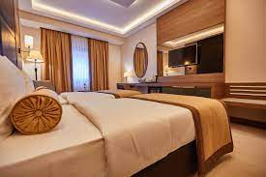
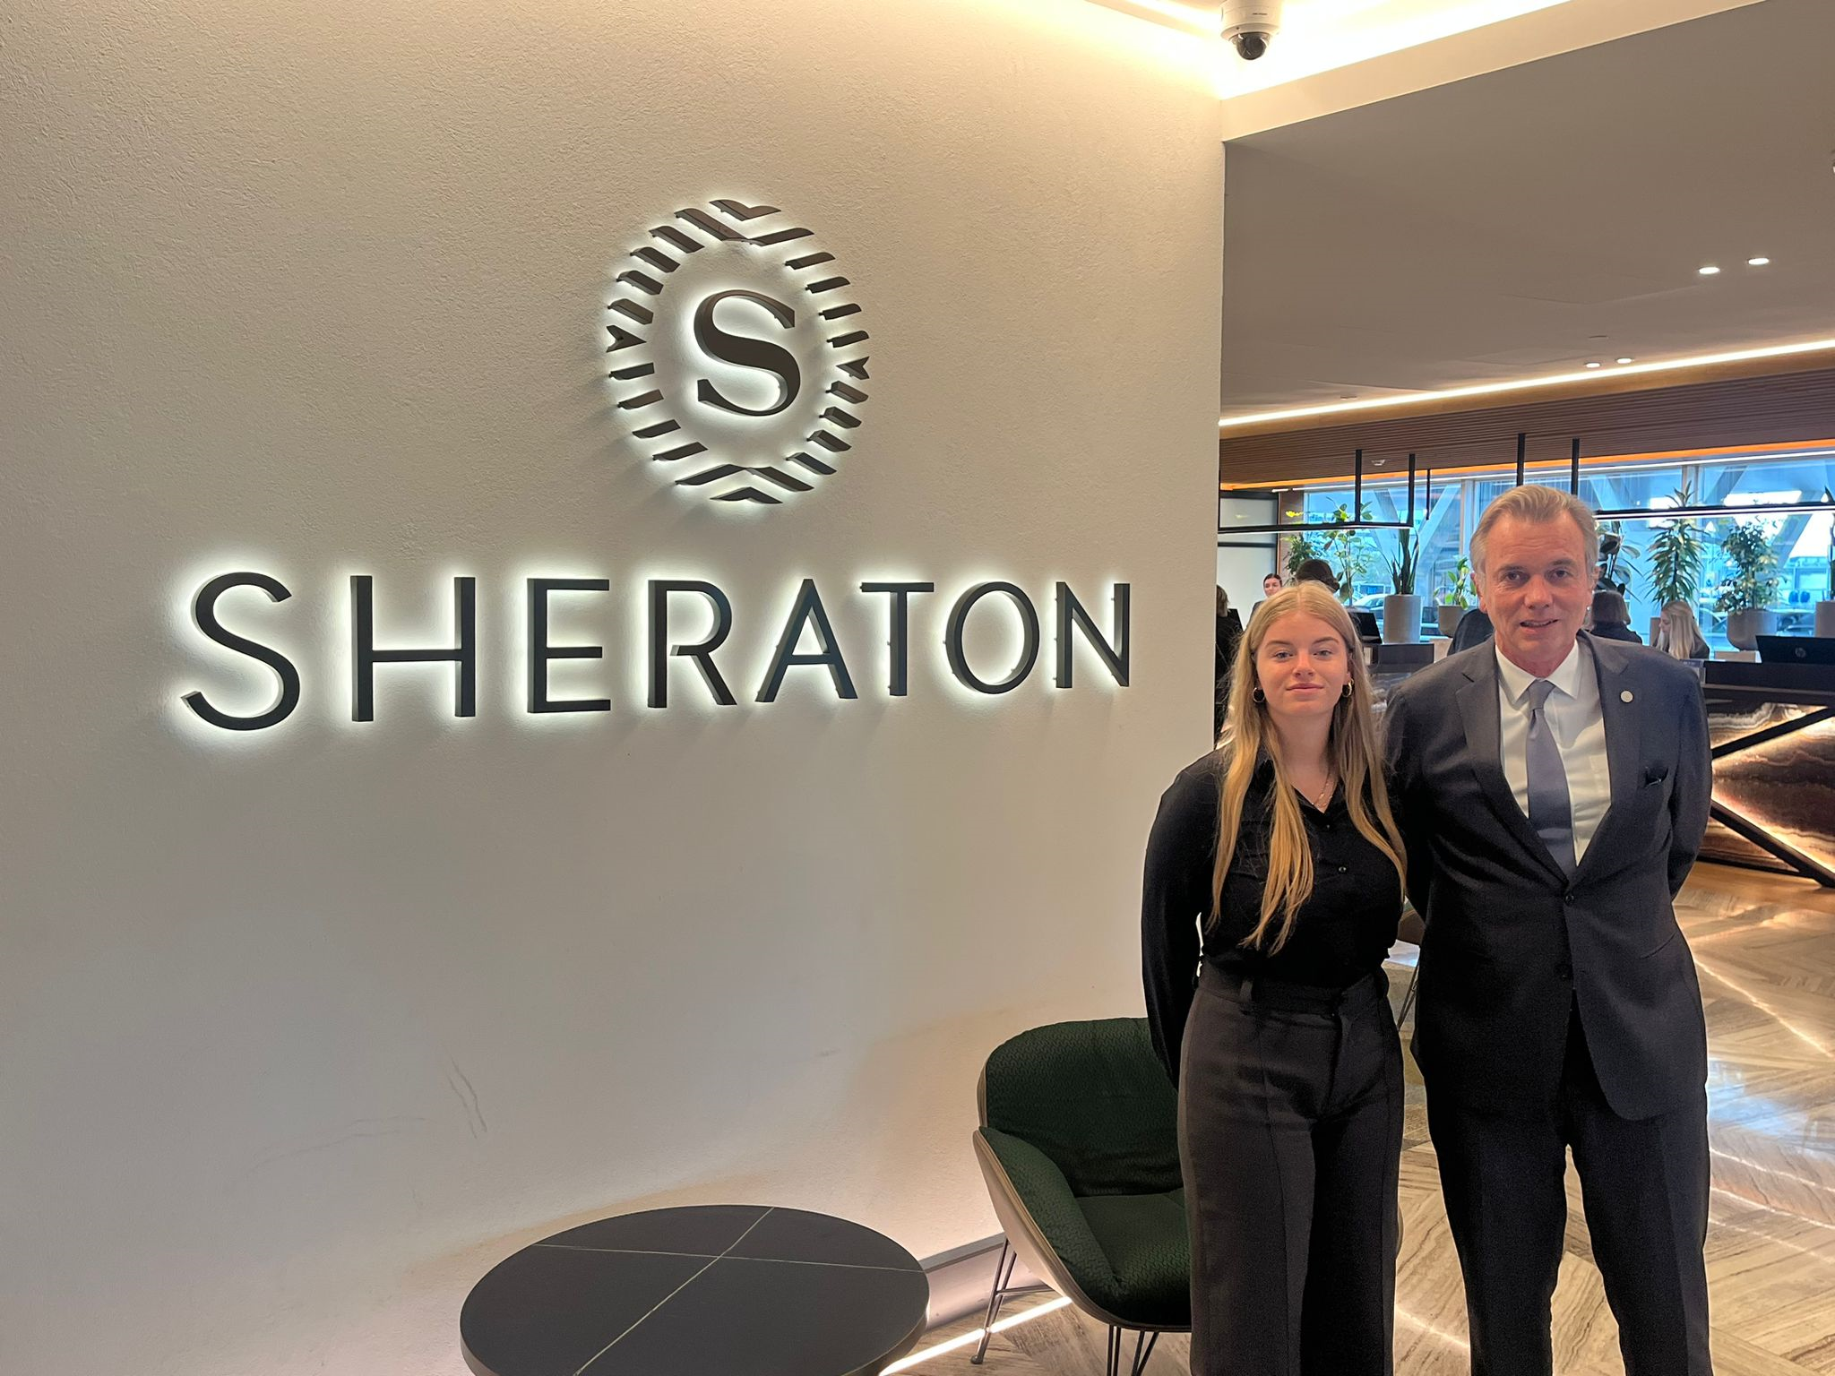
Micro analyze
Crown Hotel Vilnius
Restaurant
Staff
140 same rooms

Slide 5
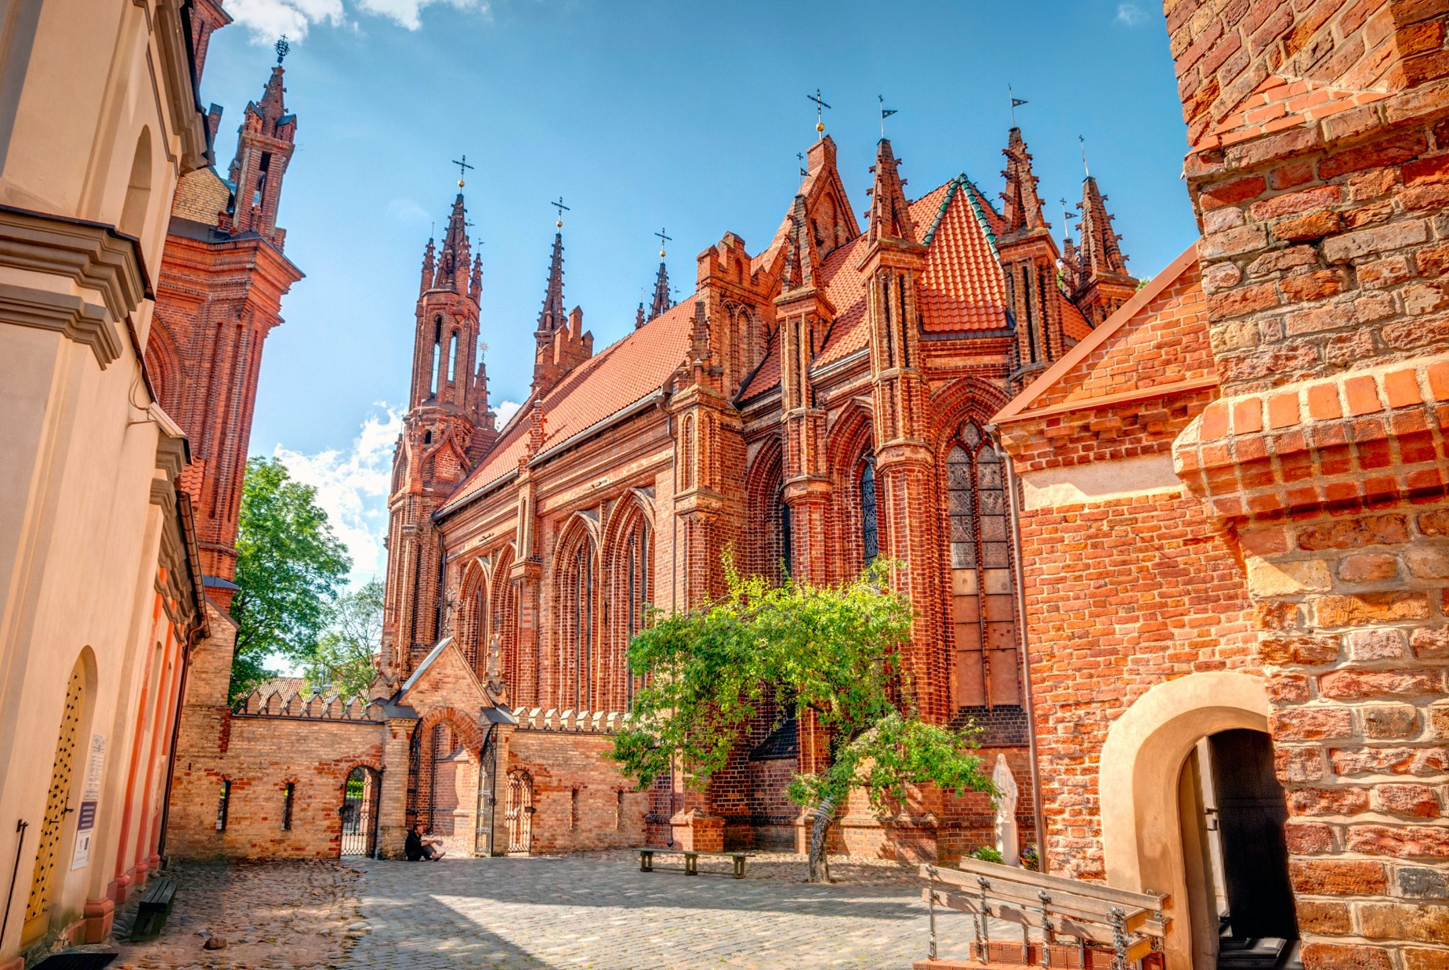




Meso analyze

Slide 6
Competitors comparison
Competitors | Concept | Sustainability | Market Segment | Staff skills | Restaurant Prices
Neris River Royale | Baltic, Exlcusive, | Silver | High | ++ | ++
Hotel Vilnele | - | Bronze | Low | 0 | +
Aurora Hotel | - | Bronze | Medium | + | +
Hotel Flora | Comfort | - | Medium | + | 0
White Stork Hotel | Comfort | Bronze | High | + | 0
Hotel Baltic | - | - | High | + | +
Hotel Palace | - | - | Low | 0 | +

Slide 7

Macro analyze trends and developments
Strengths:
Driven
Loyal staff
A+ Location
Opportunities:
Robotization
SDG
Vegan
Weaknesses:
Not sustainable
Staff skill
Threats:
World is dying
Pandamics
Wars

Slide 9

The hotel you choose to do better for the world! The durable hotel for the future.
We are a midrange plus hotel focused on experience our hospitality and do better! where guest can choose how far they want to go for the environment. The restaurant is also mid-high, with low carbon dioxide emission dishes made with good produced ingredients.

Slide 10
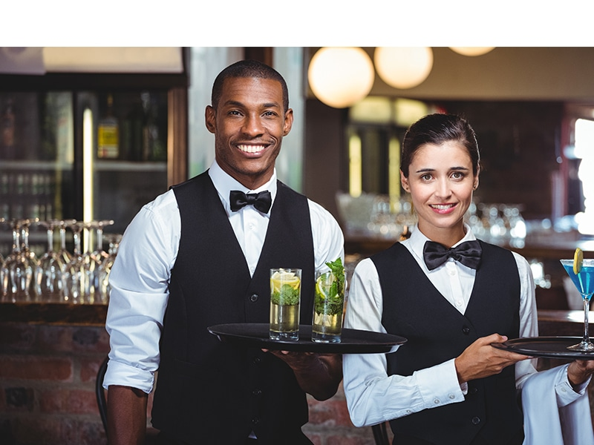

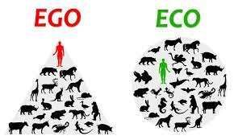




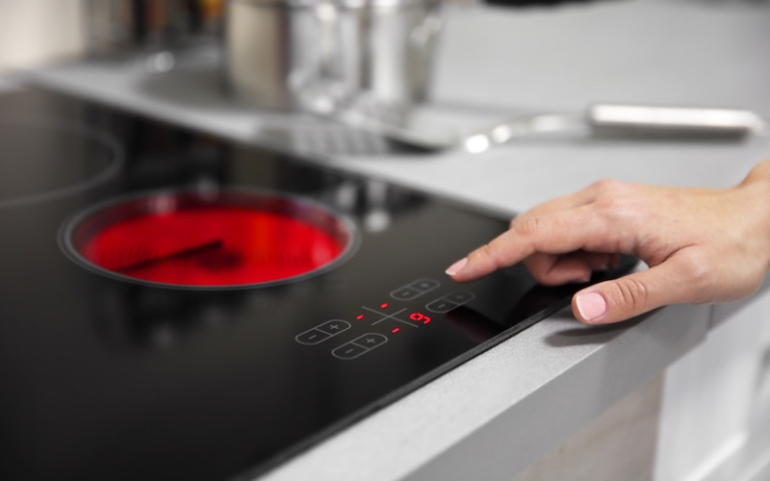

Slide 11

We treat them like family
Teamwork make, dream work

Slide 12

Coral Value
We are here to stay, no quick profit but long-term vision!

Slide 13
Round 1 – round 5
Our Journey Starts Here
Round 5
Situation and solution
Sorted put inventory for World Cup
Preperation for World Cup
Small change in menu
Slidehood.com
Round 1
Situation and solution
Pandemic
Extra cleaning
Restaurant is closed
Investing in sustainablity
Keeping/ training our durability staff
Round 3
Situation and solution
Breakfast opening
Changing menu
Keeping our good selling product and change the losers
Round 2
Situation and solution
Opening restaurant
More investments
Preperations for global warming report
Round 4
Situation and solution
Restaruant wasn’t making any profit
Preperation for World Cup

Slide 14
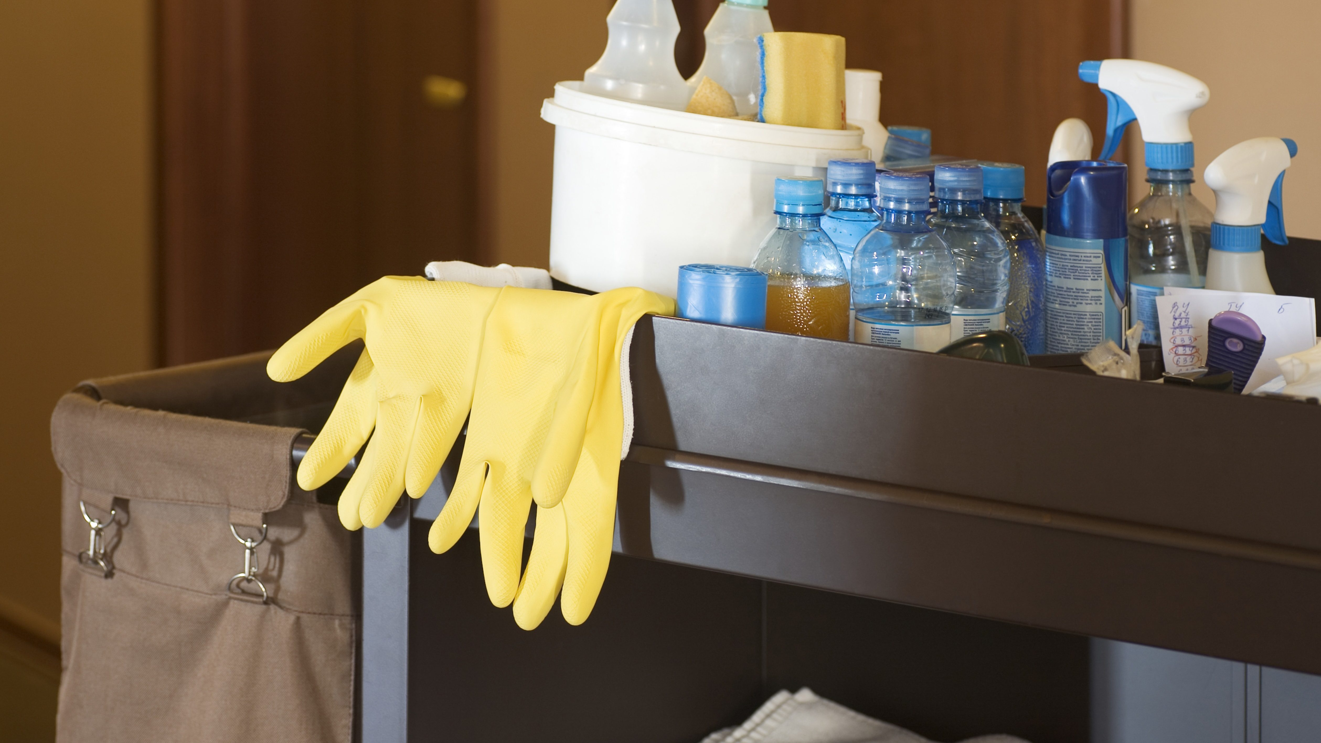
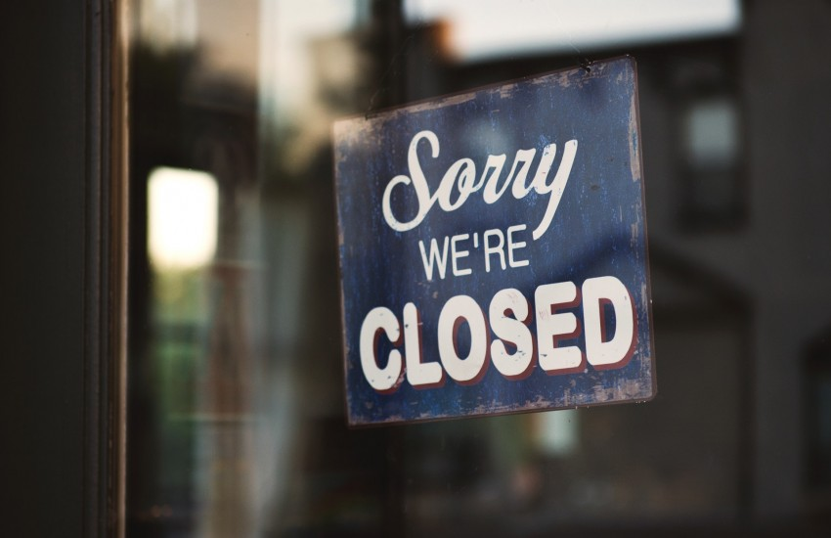

Round 1
Situation and solution
Pandemic
Extra cleaning
Restaurant is closed
Investing in sustainablity
Keeping/ training our durability staff

Slide 15
Round 1 – round 5
Our Journey Starts Here
Round 5
Situation and solution
Sorted put inventory for World Cup
Preperation for World Cup
Small change in menu
Slidehood.com
Round 1
Situation and solution
Pandemic
Extra cleaning
Restaurant is closed
Investing in sustainablity
Keeping/ training our durability staff
Round 3
Situation and solution
Breakfast opening
Changing menu
Keeping our good selling product and change the losers
Round 2
Situation and solution
Opening restaurant
More investments
Preperations for global warming report
Round 4
Situation and solution
Restaruant wasn’t making any profit
Preperation for World Cup

Slide 16
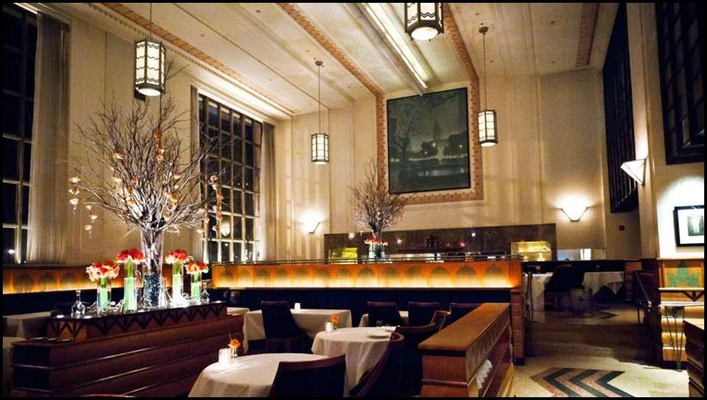

Round 2
Situation and solution
Opening restaurant
More investments and waste reduction
Preperations for global warming report

Slide 17
Round 1 – round 5
Our Journey Starts Here
Round 5
Situation and solution
Sorted put inventory for World Cup
Preperation for World Cup
Small change in menu
Slidehood.com
Round 1
Situation and solution
Pandemic
Extra cleaning
Restaurant is closed
Investing in sustainablity
Keeping/ training our durability staff
Round 3
Situation and solution
Breakfast opening
Changing menu
Keeping our good selling product and change the losers
Round 2
Situation and solution
Opening restaurant
More investments
Preperations for global warming report
Round 4
Situation and solution
Restaruant wasn’t making any profit
Preperation for World Cup

Slide 18
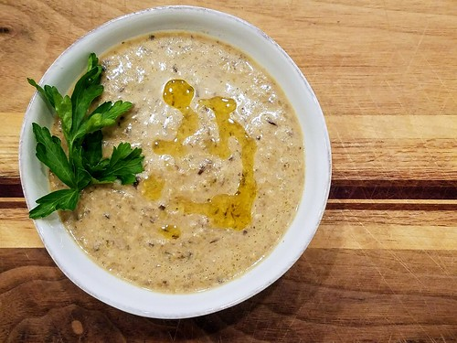
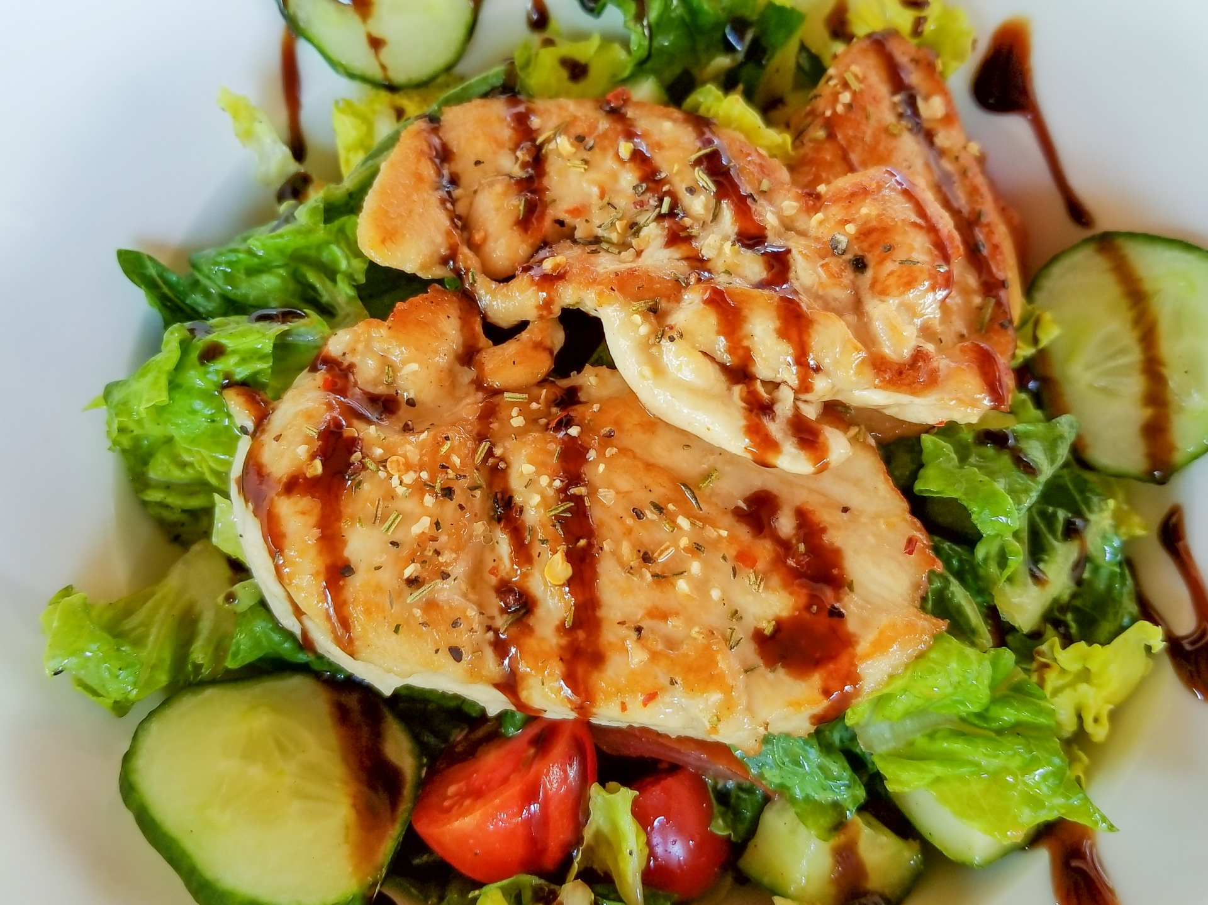
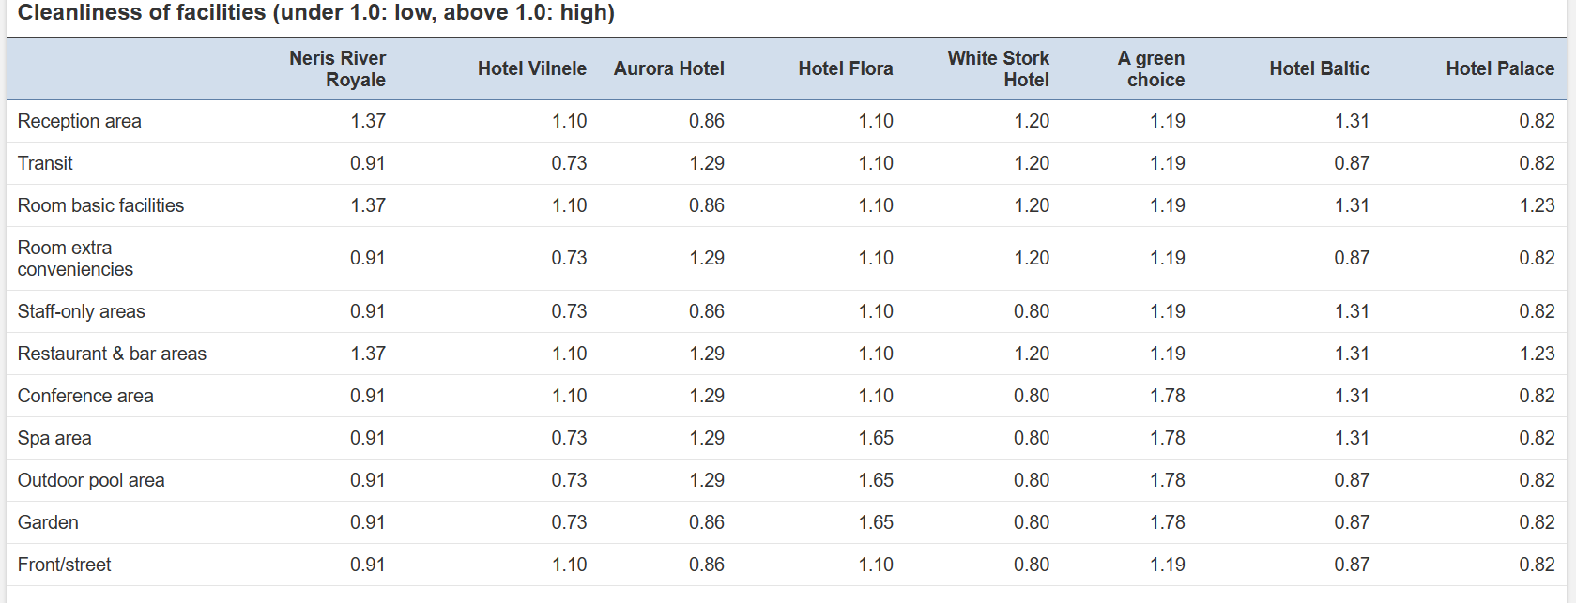
Round 3
Situation and solutions
Breakfast opening
Changing menu
Keeping our good selling product and change the least liked ones
Best sellers

Slide 19
Round 1 – round 5
Our Journey Starts Here
Round 5
Situation and solution
Sorted put inventory for World Cup
Preperation for World Cup
Small change in menu
Slidehood.com
Round 1
Situation and solution
Pandemic
Extra cleaning
Restaurant is closed
Investing in sustainablity
Keeping/ training our durability staff
Round 3
Situation and solution
Breakfast opening
Changing menu
Keeping our good selling product and change the losers
Round 2
Situation and solution
Opening restaurant
More investments
Preperations for global warming report
Round 4
Situation and solution
Restaruant wasn’t making any profit
Preperation for World Cup

Slide 20


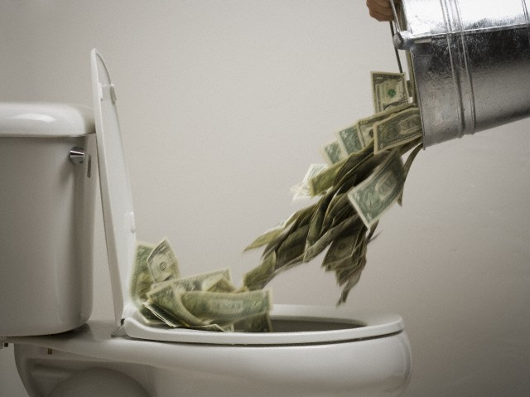
Round 4
Situations and solutions
Restaurant wasn’t making any profit
Preperation for the World Cup
Made the wrong decision

Slide 21
Round 1 – round 5
Our Journey Starts Here
Round 5
Situation and solution
Sorted put inventory for World Cup
Preperation for World Cup
Small change in menu
Slidehood.com
Round 1
Situation and solution
Pandemic
Extra cleaning
Restaurant is closed
Investing in sustainablity
Keeping/ training our durability staff
Round 3
Situation and solution
Breakfast opening
Changing menu
Keeping our good selling product and change the losers
Round 2
Situation and solution
Opening restaurant
More investments
Preperations for global warming report
Round 4
Situation and solution
Restaruant wasn’t making any profit
Preperation for World Cup

Slide 22
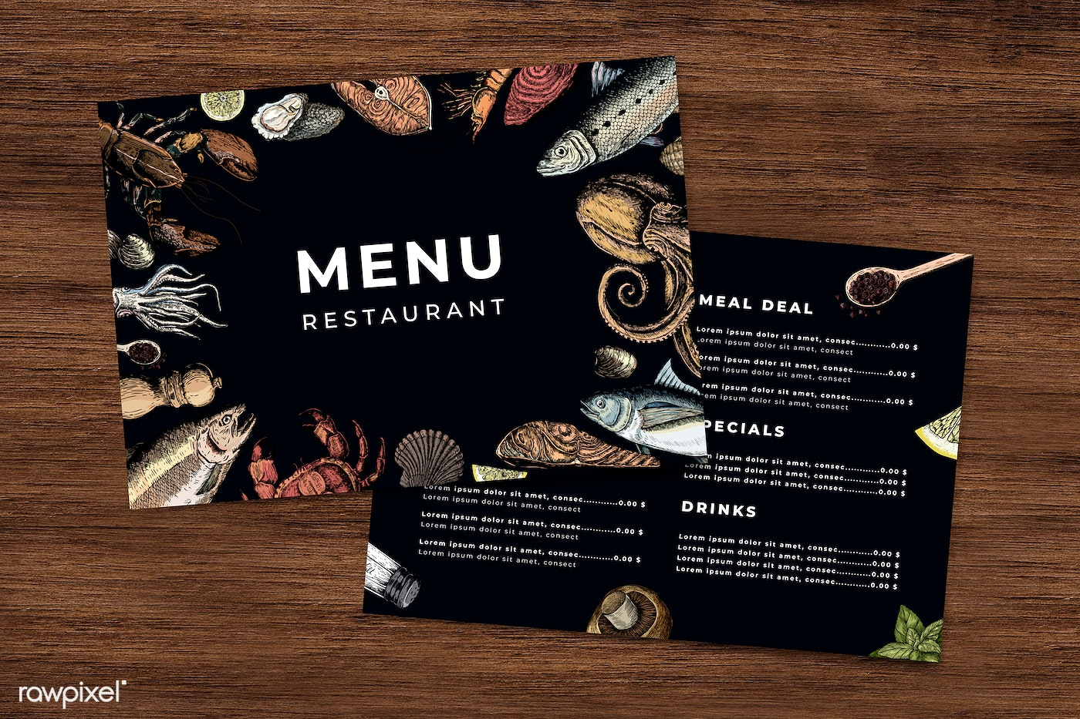

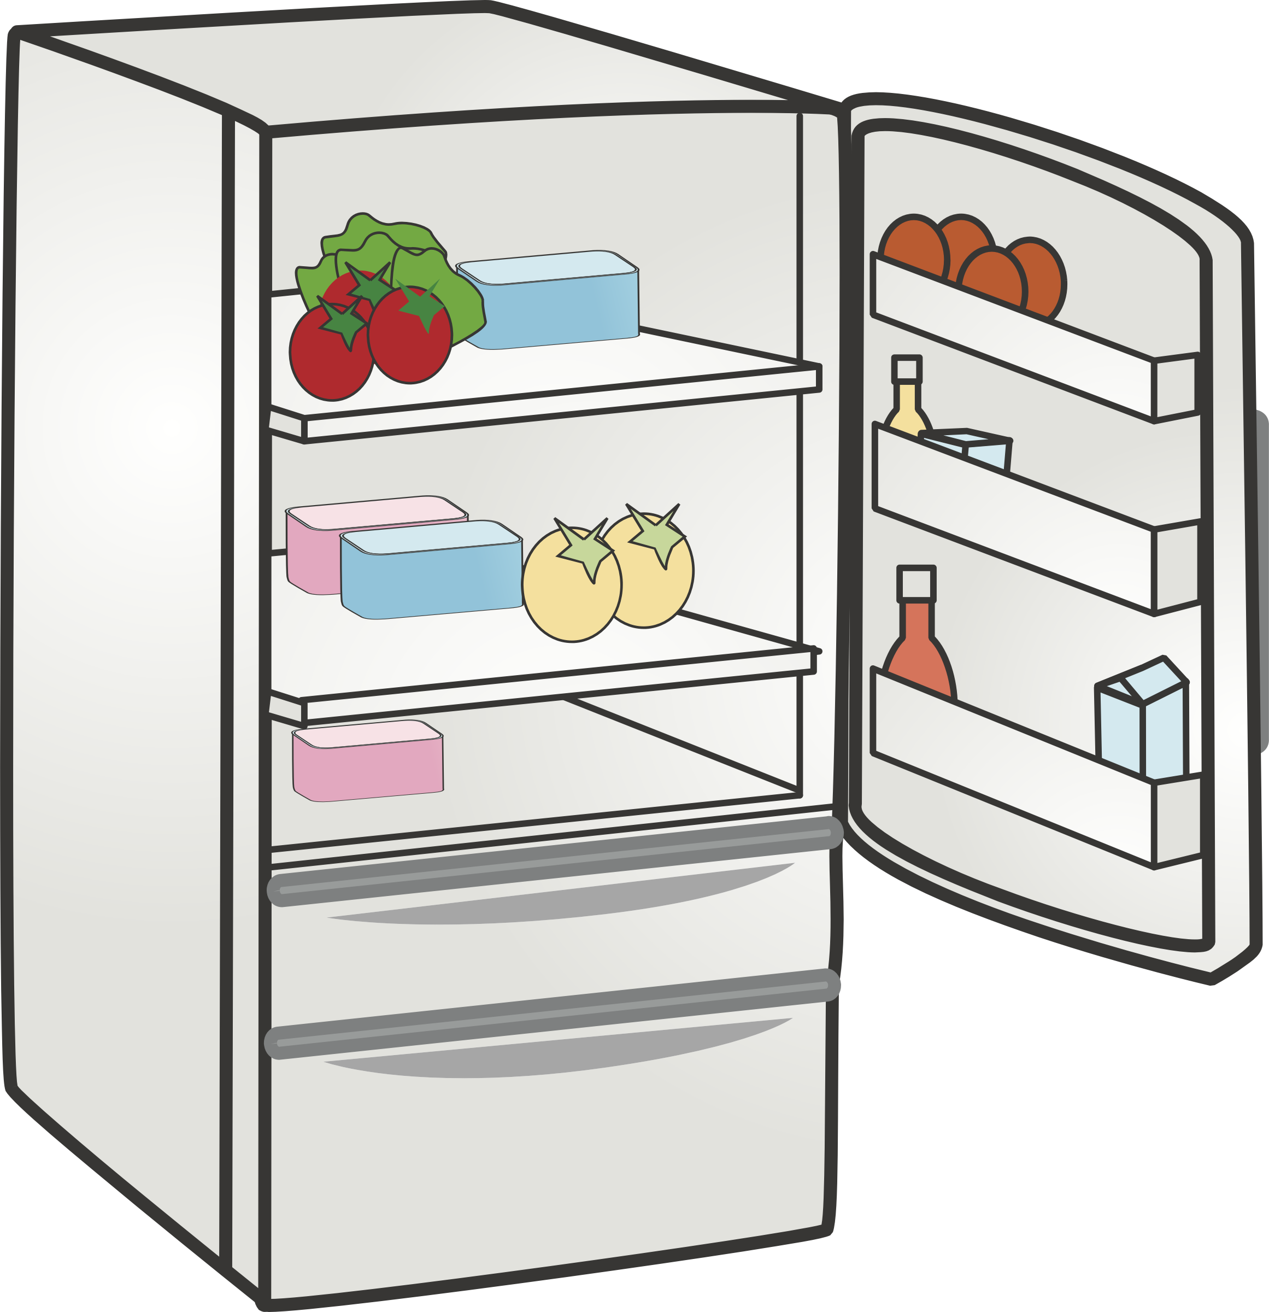
Round 5
Situation and solutions
Sorted put inventory for World Cup
Preperation for the World Cup
Small changes in the menu

Slide 23
Round 6
The pre revenue was a dissapointment because of the basketball competition, that is why we slightly increased room rates to stimulate sales, because we expect that our competitors go further up in prices.
In the restaurant we used extra cleaning because of the different types of guests and the heatwave, same with the pool and spa areas.
Our breakfast has been going well lately, we have more guests in the hotel this is why this curve has continued.
Our hotel is the cleanest out of all the competitors, so we can manage various types of guests.
We want our gold medal back and not lose any rooms over it in this round, so we changed our supplier to a more sustainable one and invested in waterless urinals.
Worst case senario:
-during the heat wave, there is a chance that the basketball game could be cancellled, so we did not raise a lot in rates, and we bought frozen meat for our new dishes exept for our runners to avoid spill.

Slide 24
Sky is the limit

Slide 25


Conclusion
By going through the rounds, we learned together what it’s like to run a hotel during various developments in the market and how we can make the world more sustainible together in the hotel industry.+
This has given us a glimpse of what our future in hospitality may be.

